Slide 1
WEB TECHNOLOGIES

Slide 2
Syllabus
UNIT - 1
INTRODUCTION TO HTML AND JAVASCRIPT
UNIT - 2
JDBC:
UNIT - 3
WEB SERVERS AND SERVLETS:
UNIT - 4
INTRODUCTION TO JSP
UNIT - 5
SEMANTIC WEB THE FUTURE OF THE INTERNET
ONTOLOGY IN COMPUTER SCIENCE:
KNOWLEDGE REPRESENTATION IN DESCRIPTION LOGIC:

Slide 3
TEXT BOOKS:
1. Jon Duckett, “Beginning Web Programming with HTML, XHTML, and CSS”, WROX, 2ndedition, 2008.
2. Marty Hall and Larry Brown, “Core Servlets and Java Server pages Vol. II”, 2nd edition,Pearson, 2007.
3. K K Breitman, M A Casanova and W Truszkowski, “Semantic Web: Concepts,Technologies and Applications”, Springer, 2009.
REFERENCEBOOKS:
1. Robert W Sebesta, “Programming the World Wide Web”, 4th edition, Pearson, 2006
2. Paul J Deitel, Harvey M Deitel and Abbey Deitel, “Internet and World Wide Web – How to program”, 5th edition, Deitel, 2009.

Slide 4
UNIT - 1
INTRODUCTION TO HTML AND JAVASCRIPT: HTML- HTML Common tags, Block level and inline
Elements, Lists, Tables, Images, Forms, Frames, Cascading style sheets, CSS Properties; Java
Script-Introduction to Java script, Objects in Java script, Dynamic HTML with Java script.

Slide 5
What is meant by WT??
Web technology refers to the means by which computers communicate with each other using markup languages and multimedia packages. It gives us a way to interact with hosted information, like websites. Web technology involves the use of hypertext markup language (HTML) and cascading style sheets (CSS).

Slide 6
What is Network?
A network is defined as a group of two or more computer systems linked together. There are many types of computer networks, including the following:
local-area networks (LANs): The computers are geographically close together (that is, in the same building).
wide-area networks (WANs): The computers are farther apart and are connected by telephone lines or radio waves.
metropolitan-area networks MANs): A data network designed for a town or city.

Slide 7
What is Internet?
The Internet is the global system of interconnected computer networks that use the Internet protocol suite (TCP/IP) to link devices worldwide. It is a network of networks.

Slide 8
What is WWW?
The World Wide Web (WWW) is a network of online content that is formatted in HTML and accessed via HTTP.
The term refers to all the interlinked HTML pages that can be accessed over the Internet.
The World Wide Web was originally designed in 1991 by Tim Berners-Lee while he was a contractor at CERN.

Slide 9
Web Page
A web page is a document that is suitable for the World Wide Web and web browsers. A web browser displays a web page on a monitor or mobile device.
The web page usually means what is visible, but the term may also refer to a computer file, usually written in HTML or a comparable markup language

Slide 10
Model View Controller
Model View Controller or MVC as it is popularly called, is a software design pattern for developing web applications.
MVC separates application into three components - Model, View and Controller.
Model represents shape of the data and business logic.
It maintains the data of the application such as databases, text data, files and/or other web resources.

Slide 11
Model View Controller
View: View is a user interface.
This is the graphical user interface of the application.
View display data using model to the user and also enables them to modify the data.
Controller handles the user request.
Typically, user interact with View, which in-tern raises appropriate URL request, this request will be handled by a controller.
The controller renders the appropriate view with the model data as a response.

Slide 12
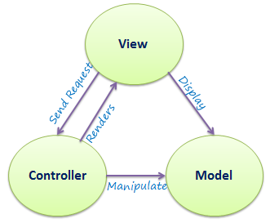
Model View Controller

Slide 13
HTML
The primary scripting language for developing web pages is HTML.
It is used to describe how a web page will appear in a browser’s window.
HTML allows us to write formatting instructions for web pages.
Web browsers interpret the formatting instructions specified for the web page and display the web page on the screen.
HTML provides simple mechanisms for formatting text, creating links and lists, inserting images, embedding audio and video etc.

Slide 14
It can also include CSS to specify the style and layout of text and other components.
Scripts written in various languages such as JS and VBScript may also be used to change the appearance of web pages and make them interactive.
HTML documents are written using HTML “tags” embedded in angular brackets.
The set of tags that we can use to write HTML documents is defined by the world wide web consortium (W3C).
W3C has published many standards for HTML

Slide 15
HTML Versions
The first version of html specification, called HTML tags, was introduced in late 1991 by Berners-Lee.
In the version, only 18 to 20 tags were Incorporated to develop simple websites.
Thirteen out of twenty still exist in the current version.
In November 1995, HTML version 2 was introduced by Internet Engineering Task Force (IETF).
In this version, several features such as forms, tables and image maps were added.
However , this version became obsolete in 2000.

Slide 16
HTML….
The world wide web consortium (W3C) published its first recommendations, HTML 3.2, in 1997. The math formulae was dropped entirely.
In the same year, W3C published HTML version 4.0, which consists of 3 flavors: strict, Transitional and Frameset.
In 1999, W3c published an enhanced version, HTML 4.01, which was modified in may 12, 2001.
In 2004, development began on HTML5 in the Web Hypertext Application Technology Working Group (WHATWG), which became a joint deliverable with the W3C in 2008, and completed and standardized on 28 October 2014
November 1, 2016HTML 5.1 was published as a W3C Recommendation
The markup tells the Web browser how to display a Web page's text, images, sound and video files for the user.
The individual markup codes are referred to as elements (but many people also refer to them as tags).

Slide 17
HTML Document Structure
<HTML>
<HEAD>
<TITLE> My web page </TITLE>
</HEAD>
<BODY>
Content of the document
</BODY>
</HTML>

Slide 18
HTML Document Structure
The HTML document is divided into two major parts:
HEAD: contains information about the document:
Title of the page (which appears at the top of the browser window)
JavaScript and Style sheets generally require statements in the document Head
BODY: Contains the actual content of the document
This is the part that will be displayed in the browser window

Slide 19
HTML Tags
All HTML tags are made up of a tag name and sometimes they are followed by an optional list of attributes which all appear between angle brackets < >
Ex: <h1>hi</h1>
<p>bye</p>

Slide 20
Simple program
<HTML>
<head>
<title>first</title>
</head>
<body>
<H1>Hello World</H1>
</body>
</HTML>

Slide 21
Text Formatting Tags
Text formatting tags modify the text between the opening tag and the closing tag
<b> | bold
<i> | italic
<u> | underlined
<sup> | Sample^{superscript}
<sub> | Sample_{subscript}
<MARK> | Defines marked/highlighted text
font | To change style of text
<pre></pre> | Preformatted text
<del></del> | Deleted text – strike through
<hr> | Defines horizontal line

Slide 22
font
It is used to change style of specific text
<font face=“verdana” size=“20” color=“red”>Web Technologies </font>

Slide 23
Cont..
<html>
<body>
<i>CSE</i><br>
<u>ECE</u><br>
<del>mech</del><br>
<b>Vignan</b><br>
2<sup>2<sup>
<hr>
<pre>
sno name
1 ram
</pre>
<hr>
<font face=“verdana” size=“20” color=“blue”>Web Technologies </font><BR>
HI THIS IS <MARK>CSE-A</MARK>
</body>
</html>

Slide 24
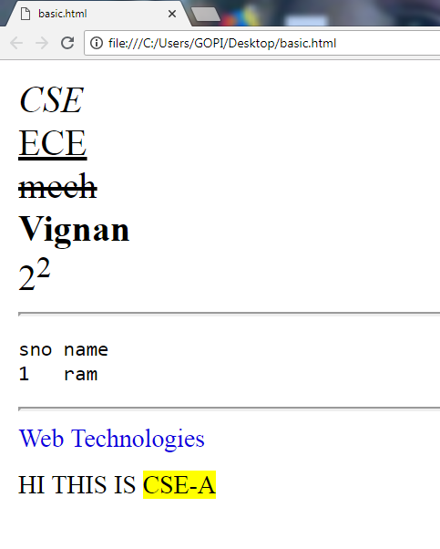

Slide 25
<!DOCTYPE html>
<html>
<body>
<p><font size="20" color="red">This is some text!</font></p>
<p><font size="2" color="blue">This is some text!</font></p>
<p><font face="verdana" color="green">This is some text!</font></p>
<p><strong>Note:</strong> The font element is not supported in HTML5. Use CSS instead.</p>
</body>
</html>

Slide 26
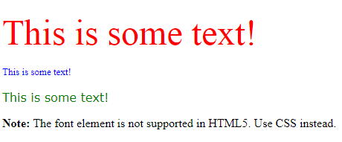

Slide 27
Heading tags
HTML defines six levels of headings.
The heading elements are H1, H2, H3, H4, H5, and H6 with H1 being the highest (or most important) level and H6 the least.
For example:
<H1>This is a top level heading</H1> Here is some text. <H2>Second level heading</H2> Here is some more text.
<h1>Main heading</h1>
<h2>sub heading</h2>
<h3>sub heading</h3>

Slide 28
CONT …
<HTML>
<BODY>
<H1>This is a top level heading</H1>
<H2>Second level heading</H2>
<h3> heading-3</h3>
<h4>heading-4</h4>
<h5> heading-5</h5>
<h6> heading-5</h6>
</BODY>
</HTML>

Slide 29
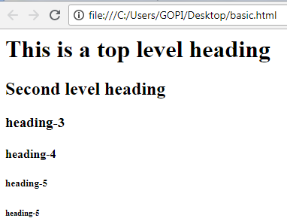

Slide 30
HTML Links – <a> tag
The <a> tag defines a hyperlink, which is used to link from one page to another.
Hyperlinks allow visitors to navigate between Web sites by clicking on words, phrases, and images.
This tag is called anchor tag and anything between the opening <a> tag and the closing </a> tag becomes part of the link and a user can click that part to reach to the linked document.
<a href="Document URL" ... attributes-list>LinkText</a>

Slide 31
The href attribute specifies the destination address of the link.
By default, links will appear as follows in all browsers:
An unvisited link is underlined and blue
A visited link is underlined and purple
An active link is underlined and red

Slide 32
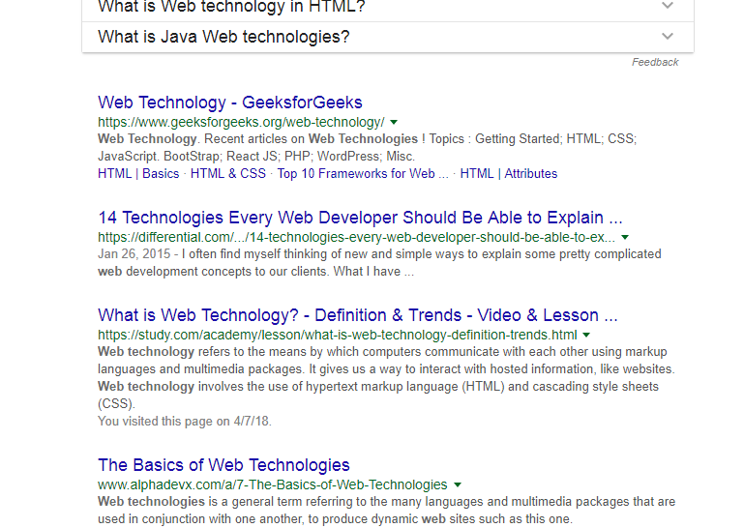
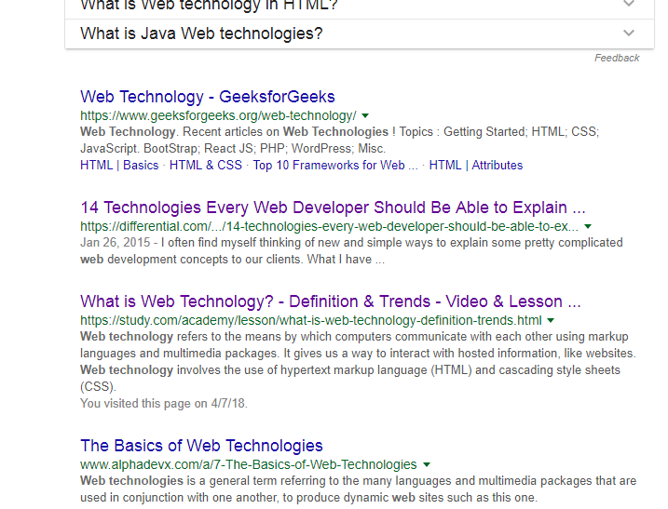

Slide 33
<!DOCTYPE html>
<html>
<body>
<a href="https://www.w3schools.com">Visit W3Schools.com!</a>
</body>
</html>

Slide 34
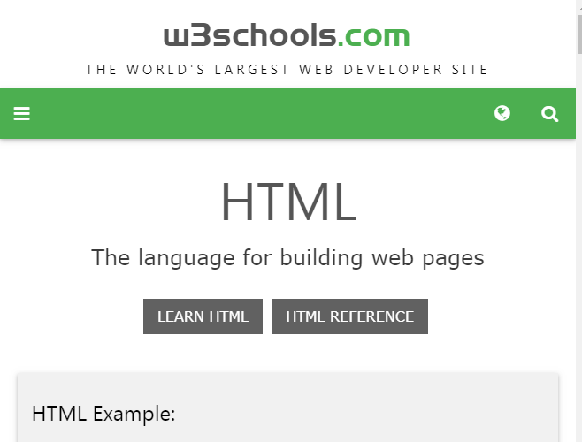
Visit W3Schools.com!

Slide 35
HTML Links – Hyperlinks
target Attribute
This attribute is used to specify the location where linked document is opened.
Option Description
_blank Opens the linked document in a new window or tab.
_self Opens the linked document in the same frame

Slide 36
HTML Links – Hyperlinks
<html>
<body>
<p>Click any of the following links</p>
<a href=head.html>LINK</a> <br>
<a href=head.html target="_blank">Opens in New</a><br>
<a href=link.htm target="_self">Opens in Self</a>
</body>
</html>

Slide 37
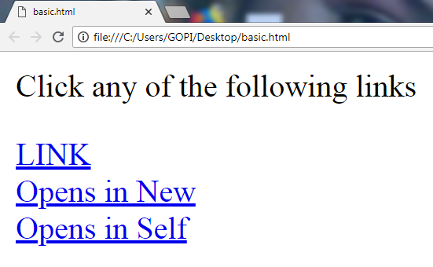

Slide 38
<img> Tag
The HTML <img> tag is used to put an image in an HTML document
<img src="Image URL« ... attributes-list/>
Attribute | Value | Description
align | Top ,bottom middle ,left right | Specifies the alignment of an image according to surrounding elements
alt | text | Specifies an alternate text for an image
border | pixels | Specifies the width of the border around an image
height | pixels | Specifies the height of an image
width | pixels | Specifies the width of an image
src | URL | Specifies the URL of an image

Slide 39
<img> Tag Code
<html>
<body>
<img src="rose.jpg" style="width:420px;height:420px;border:0;">
</body>
</html>

Slide 40


Slide 41
4. LISTS
HTML supports 3 types of lists
unordered
Ordered
definition lists

Slide 42
1. Unordered lists
An unordered list is a collection of related items that have no special order or sequence.
Each item in the list is marked with a bullet.
This list is created by using HTML <ul> tag.
An unordered list starts with the <ul> tag. Each list item starts with the <li> tag.
<ul type=“circle|disc|compact”>
<ul> <li>Coffee</li> <li>Tea</li> <li>Milk</li> </ul>
Coffee
Tea
Milk

Slide 43
Unordered lists
The type Attribute
You can use type attribute for <ul> tag to specify the type of bullet you like. By default it is a disc.
Following are the possible options:
<ul type=“disc"> <ul type=“circle"> <ul type=“square">
Apple
Orange
Pear
Apple
Orange
Pear
Apple
Orange
Pear

Slide 44
Example
<html>
<body>
<h1>Explaining about bullet lists</h1>
<ul type=“disc”>
<li>Bullet point number one</li>
<li>Bullet point number two</li>
<li>Bullet point number three</li>
</ul>
</body>

Slide 45
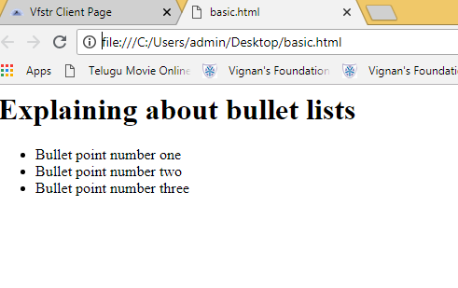
Output:

Slide 46
2. Ordered Lists
An ordered list is also a list of items. The list items are marked with numbers.
An ordered list starts with the <ol> tag. Each list item starts with the <li> tag.
The numbering starts at one and is incremented by one for each successive ordered list element tagged with <li>.
Syntax:
<ol type=“A”|”I”|”i”|”1”>

Slide 47
Ordered Lists
<ol> <li>Coffee</li> <li>Tea</li> <li>Milk</li> </ol>
Coffee
Tea
Milk

Slide 48
The Type Attribute
Type | Description
type="1" | The list items will be numbered with numbers (default)
type="A" | The list items will be numbered with uppercase letters
type="a" | The list items will be numbered with lowercase letters
type="I" | The list items will be numbered with uppercase roman numbers
type="i" | The list items will be numbered with lowercase roman numbers

Slide 49
Example:
<html>
<body>
<ol type=“1”>
<li>Point number one</li>
<li>Point number two</li>
<li>Point number three</li>
</ol>
</body>
</html>

Slide 50
Output Of The Program:

Slide 51
3. Definition Lists
A definition list is not a list of single items.
It is a list of items (terms), with a description of each item (term).
A definition list starts with a <dl> tag (definition list).
Each term starts with a <dt> tag (definition term).
Each description starts with a <dd> tag (definition description).
<dl>
<dt>HTML</dt>
<dd>A markup language …</dd>
<dt>CSS</dt>
<dd>Language used to …</dd>
</dl>

Slide 52
Example:
<html>
<body>
<ol type="1">
<li>Apple</li>
<li>Orange</li>
<li>Grapefruit</li>
</ol>
<ul type="disc">
<li>Apple</li>
<li>Orange</li>
<li>Grapefruit</li>
</ul>
<dl>
<dt>HTML</dt>
<dd>AThe primary scripting language for developing web pages </dd>
<dt>Javascript</dt>
<dd>an object-oriented computer programming language commonly used to create interactive effects within web browsers</dt>
</dl>
</body>
</html>

Slide 53
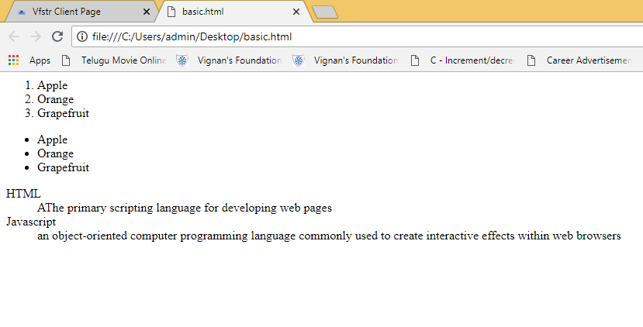

Slide 54
Tables
Tables represent tabular data
A table consists of one or several rows
Each row has one or more columns
The HTML tables allow web authors to arrange data like text, images, links, other tables, etc. into rows and columns of cells.
The HTML tables are created using the <table> tag
The <tr> tag is used to create table rows and <td> tag is used to create data cells.
Table heading can be defined using <th> tag.
<td> tag, which is used to represent actual data cell.

Slide 55
Cont ..
<table style border=1>
<tr>
<th>Name</th>
<th>Age</th>
</tr>
<tr>
<td>Smith</td>
<td>50</td>
</tr>
<tr>
<td>Jackson</td>
<td>94</td>
</tr>

Slide 56
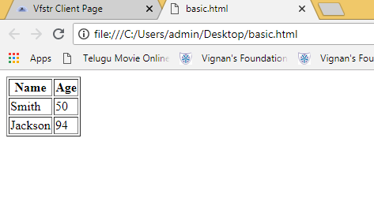

Slide 57
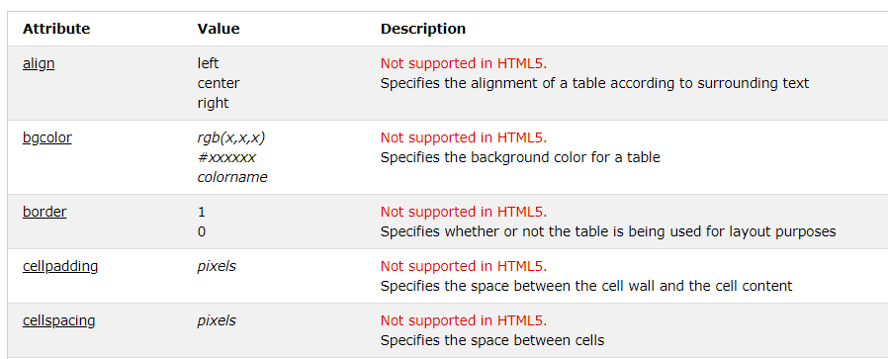
Attributes

Slide 58
Cellpadding and Cellspacing Attributes
<table style border=1 cellpadding="10" cellspacing="10">
<tr>
<th>Name</th>
<th>Age</th>
</tr>
<tr>
<td>Smith</td>
<td>50</td>
</tr>
<tr>
<td>Jackson</td>
<td>94</td>
</tr>
</table>

Slide 59
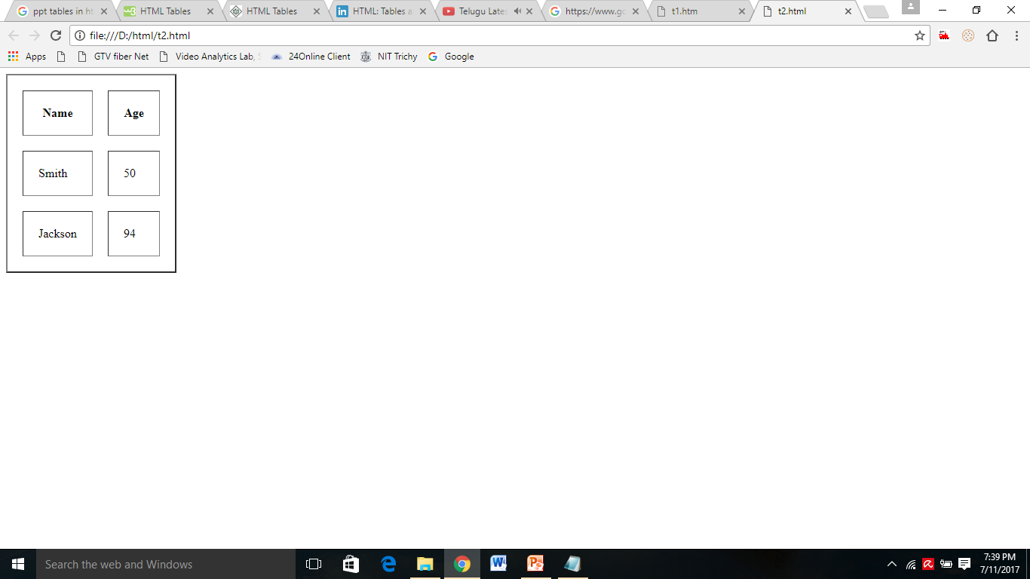

Slide 60
Colspan and Rowspan Attributes
colspan attribute merge two or more columns into a single column.
rowspan merge two or more rows.
Ex:
<table border="1" bordercolor="green" bgcolor="yellow">
<tr><th>Column 1</th><th>Column 2</th></tr>
<tr><td rowspan="2">Row 1 Cell 1</td><td>Row 1 Cell 2</td></tr>
<tr><td>Row 2 Cell 2</td></tr>
<tr><td colspan="2">Row 3 Cell 1</td></tr>
</table>

Slide 61
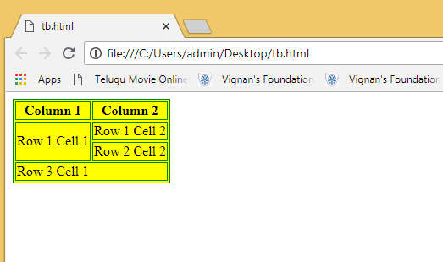

Slide 62
Table Caption
The caption tag will serve as a title or explanation for the table and it shows up at the top of the table.
<caption>This is the caption</caption>

Slide 63
HTML Frames
HTML frames are used to divide your browser window into multiple sections where each section can load a separate HTML document.
A collection of frames in the browser window is known as a frameset.
The window is divided into frames.
<frameset> tag used to divide the window into frames.
The rows attribute of <frameset> tag defines horizontal frames and cols attribute defines vertical frames.
Each frame is indicated by <frame> tag and it defines which HTML document shall open into the frame.

Slide 64
HTML Frames
<frameset [cols=“%,%”] [rows=“%,%”]> ……</frameset>
To fill the data in frames
<frame src=“filename”>

Slide 65
Example:
<html>
<frameset cols="25%,*,25%">
<frame src="list.html">
<frame src="head.html">
<frame src="img.html">
</frameset>
</html>

Slide 66
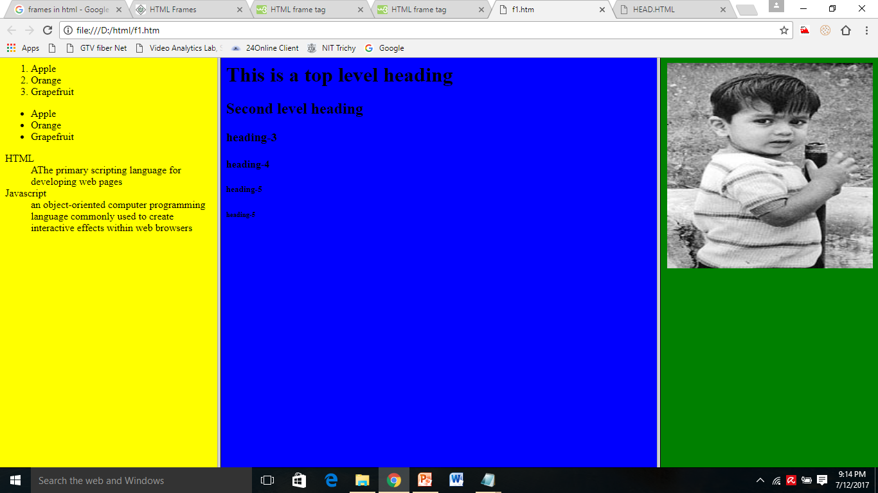
Example:

Slide 67
<!DOCTYPE html>
<html>
<frameset rows="50%,50%">
<frame src="frame_a.htm">
<frameset cols="25%,75%">
<frame src="frame_b.htm">
<frame src="frame_c.htm">
</frameset>
</frameset>
</html>

Slide 68
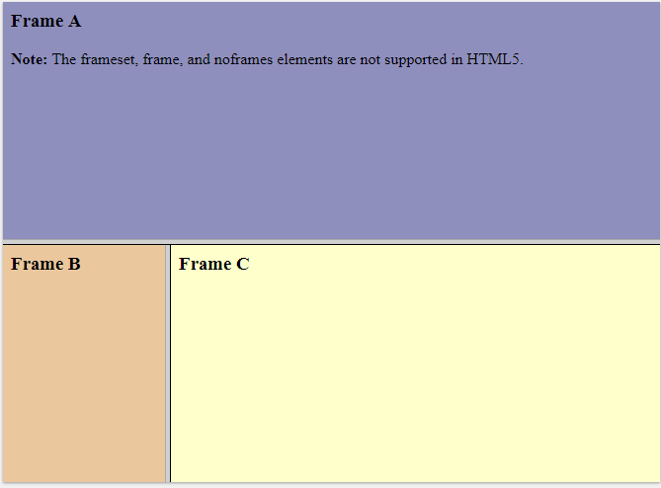

Slide 69
FORMS
HTML Forms are required when you want to collect some data from the site visitor.
For example during user registration you would like to collect information such as name, email address, credit card, etc.
A form will take input from the site visitor and then will post it to a back-end application such as CGI, Servlets ,JSP or PHP script etc.
There are various form elements available like text fields, text area fields, drop-down menus, radio buttons, checkboxes, etc.

Slide 70
FORMS
The HTML <form> tag is used to create an HTML form and it has following syntax:
<form action="Script URL" method="GET|POST">
form elements like input, text area etc.
</form>
Attribute | Description
action | url of Backend script ready to process your passed data.
method | Method to be used to send data. The most frequently used are GET and POST methods.

Slide 71
HTML Form Controls or Elements
There are different types of form controls that you can use to collect data using HTML form
Text Input Controls
Checkboxes Controls
Radio Box Controls
Select Box Controls
File Select boxes
Submit and Reset Button

Slide 72
Text Input Controls
Text Field
Password field
Text Area
Text Field:
This is used for items that require only one line of user input, such as search boxes or names.
They are created using HTML <input> tag.
Syntax:
<input type="text" name="first_name" value=“initial value”/>

Slide 73
Cont …
Password field:
This is also a single-line text input but it masks the character as soon as a user enters it.
They are also created using HTML <input> tag but type attribute is set to password.
Syntax:
<input type=“password" name=“password" />
Textarea:
This is used when the user is required to give details that may be longer than a single sentence.
Multi-line input controls are created using HTML <textarea> tag.
<textarea rows="5" cols="50" name="description">

Slide 74
Example
<html>
<body bgcolor=“yellow">
<form >
User ID : <input type="text" name="user_id" />
<br>
Password: <input type="password" name="password" /><br>
Description : <br>
<textarea rows="5" cols="50" name="description">
Enter description here...
</textarea>
</form>
</body>
</html>

Slide 75
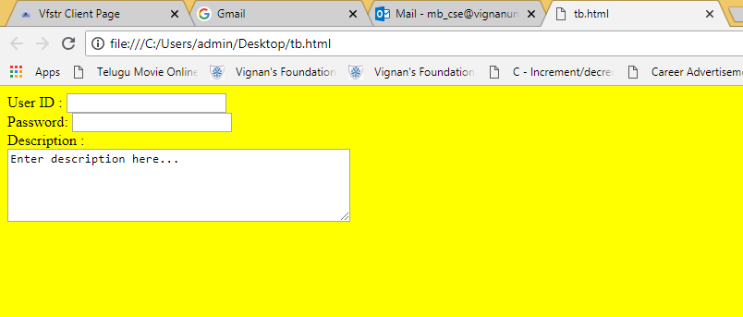

Slide 76
Radio Buttons
Radio buttons are used when out of many options, just one option is required to be selected.
They are also created using HTML <input> tag but type attribute is set to radio.
Syntax:
<input type="radio" name=“name" value=“value">
Attribute | Description
type | Indicates the type of input control and for radio button input control it will be set to radio.
name | Used to give a name to the control which is sent to the server to be recognized and get the value.
value | The value that will be used if the radio box is selected.
checked | Set to checked if you want to select it by default.

Slide 77
OUTPUT:
<html>
<body bgcolor="pink">
<form>
<input type="radio" name="subject" value="maths"> Maths
<input type="radio" name="subject" value="physics"> Physics
</form>
</body>
</html>

Slide 78
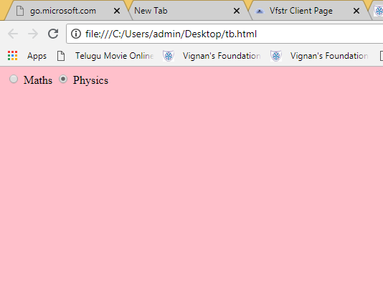

Slide 79
Checkboxes
Checkboxes are used when more than one option is required to be selected.
They are also created using HTML <input> tag but type attribute is set to checkbox
Syntax:
<input type="checkbox" name=“name" value="on">
Attribute | Description
type | Indicates the type of input control and for checkbox input control it will be set to checkbox.
name | Used to give a name to the control which is sent to the server to be recognized and get the value.
value | The value that will be used if the checkbox is selected.
checked | Set to checked if you want to select it by default.

Slide 80
Example
<html>
<body bgcolor="blue">
<form>
<input type="checkbox" name="maths" value="on"> Maths
<input type="checkbox" name="physics" value="on"> Physics
</form>
</body>
</html>

Slide 81
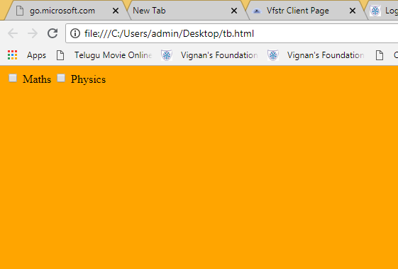

Slide 82
<html>
<body>
<form action="/action_page.php" method="get">
<input type="checkbox" name="vehicle" value="Bike"> I have a bike<br>
<input type="checkbox" name="vehicle" value="Car" checked="checked"> I have a car<br>
<input type="submit" value="Submit">
</form>
</body>
</html>

Slide 83
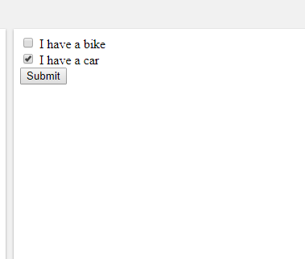

Slide 84
Select Box
A select box, also called drop down box which provides option to list down various options in the form of drop down list, from where a user can select one or more options.
<select name="dropdown">
<option value="Maths" selected>Maths</option>
<option value="Physics">Physics</option> </select>

Slide 85
Example
<select name=”selColor”>
<option selected=”selected” value=”“>Select color</option>
<option value=”red”>Red</option>
<option value=”green” selected>Green</option>
<option value=”blue”>Blue</option>
</select>

Slide 86
Output

Slide 87
File Select boxes
If you want to allow a user to upload a file to your web site, you will need to use a file upload box, also known as a file select box.
This is also created using the <input> element but type attribute is set to file.
Syntax :
<input type="file" name="fileupload" accept="image/*" />
Attribute | Description
name | Used to give a name to the control which is sent to the server to be recognized and get the value.
accept | Specifies the types of files that the server accepts.

Slide 88
File Select boxes
<html>
<body>
<form>
<input type="file" name="fileupload" accept="image/*" />
</form>
</body>
</html>

Slide 89
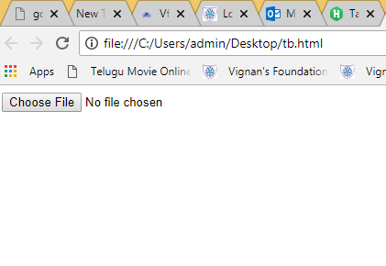

Slide 90
Button Controls
There are various ways in HTML to create clickable buttons. You can also create a clickable button using <input> tag by setting its type attribute to button.
The type attribute can take the following values:
Type | Description
submit | This creates a button that automatically submits a form.
reset | This creates a button that automatically resets form controls to their initial values.
image | This creates a clickable button but we can use an image as background of the button.

Slide 91
<html>
<body bgcolor="s">
<form>
<input type="submit" name="submit" value="Submit" />
<input type="reset" name="reset" value="Reset" />
<input type="image" name="imagebutton" src="fl.jpg" />
</form>
</body>
</html>

Slide 92
Fieldsets & Labels
Fieldsets are used to enclose a group of related form fields:
The <legend> is used to set the fieldset's title.
<fieldset>
<legend>Title</legend>
</fieldset>
Form labels are used to associate an text to a form field
<label>First Name</label>

Slide 93
<html>
<form method="post" action="form.aspx">
<fieldset>
<legend>Client Details</legend>
<Label>Name:</label><input type="text" id="Name" />
<Label>Mobile :</label> <input type="text" id="Phone" />
</fieldset>
</html>

Slide 94
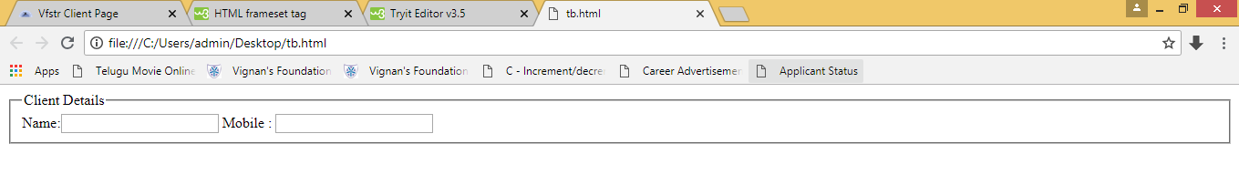

Slide 95
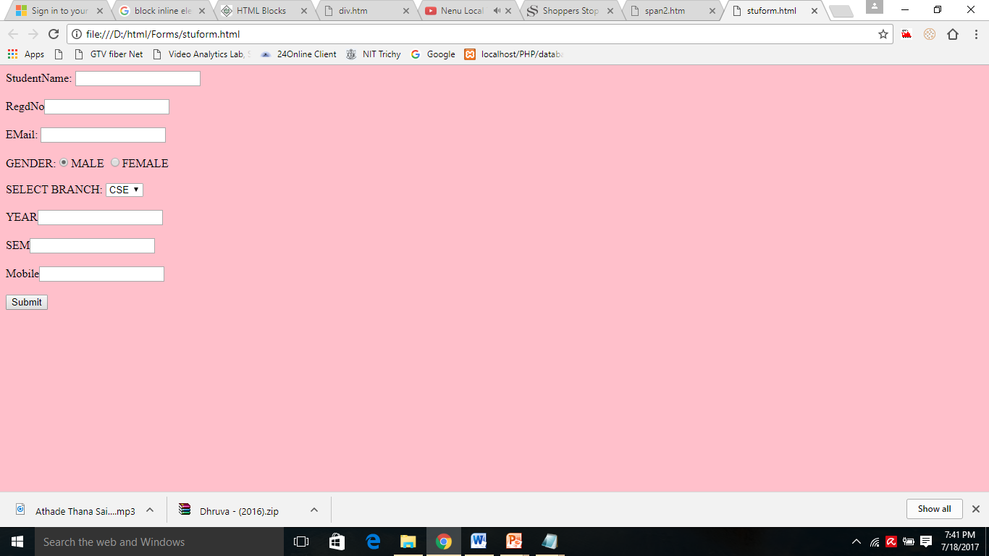

Slide 96
<html>
<body bgcolor="pink">
<form name="GForm" action="/PHP/database/student.php" method="POST">
StudentName: <input type="text" name="sname"/>
<br><br>
RegdNo<input type="text" name="sno"/>
<br><br>
EMail: <input type="text" name="smail"/>
<br><br>
GENDER:<input type="radio" name="sgender" value="male" checked>MALE
<input type="radio" name="sgender" value="female">FEMALE
<br><BR>
SELECT BRANCH:
<select name="sbranch" size="1">
<option>CSE</option>
<option>ECE</option>
<option>IT</option>
</select>
<br><br>
YEAR<input type="text" name="syear"/>
<br><br>
SEM<input type="text" name="ssem"/>
<br><br>
Mobile<input type="text" name="smobile"/>
<br><br>
<input type="submit" value="Submit">
</form>
</body>
</html>

Slide 97
<marquee> tag
An HTML marquee is a scrolling piece of text displayed either horizontally across or vertically down your webpage depending on the settings. This is created by using HTML <marquee> tag.
<marquee attribute_name="attribute_value"....more attributes> One or more lines or text message or image </marquee>

Slide 98
<marquees> tag
Attribute | Description
width | This specifies the width of the marquee. This can be a value like 10 or 20% etc.
height | This specifies the height of the marquee. This can be a value like 10 or 20% etc.
direction | This specifies the direction in which marquee should scroll. This can be a value like up, down, left or right.
loop | This specifies how many times to loop. The default value is INFINITE, which means that the marquee loops endlessly.
bgcolor | This specifies background color in terms of color name or color hex value.

Slide 99
<html>
<head>
<title>Example for HTML Marquee Tag</title>
</head>
<marquee width="40%" direction="up" height="30%">
This is sample scrolling text.
</marquee>
</html>

Slide 100
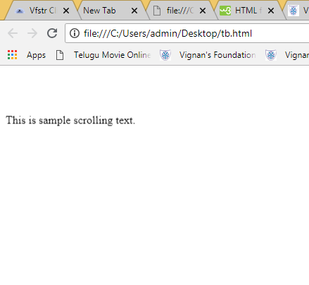

Slide 101
Block and Inline Elements
Block Elements:
Block elements add a line break before and after them
<p>, <h1>, <h2>, <h3>, <h4>, <h5>, <h6>, <ul>, <ol>, <dl>, <pre>, <hr />, <div> .
They all start on their own new line, and anything that follows them appears on its own new line.

Slide 102
<div> tag
<div> creates logical divisions within a page
Block style element
Used with CSS
This is the very important block level tag which plays a big role in grouping various other HTML tags and applying CSS on group of elements.
Even now <div> tag can be used to create webpage layout where we define different parts ( Left, Right, Top etc) of the page using <div> tag.

Slide 103
<html>
<body>
<div style="color:red">
<h4>This is first group</h4>
<p>Following is a list of vegetables</p>
<ol>
<li>Beetroot</li>
<li>Ginger</li>
<li>Potato</li>
</ol>
</div>
<div style="color:green">
<h4>This is second group</h4>
<p>Following is a list of fruits</p>
<ul>
<li>Apple</li>
<li>Banana</li>
<li>Mango</li>
</ul>
</div>
</body>
</html>

Slide 104
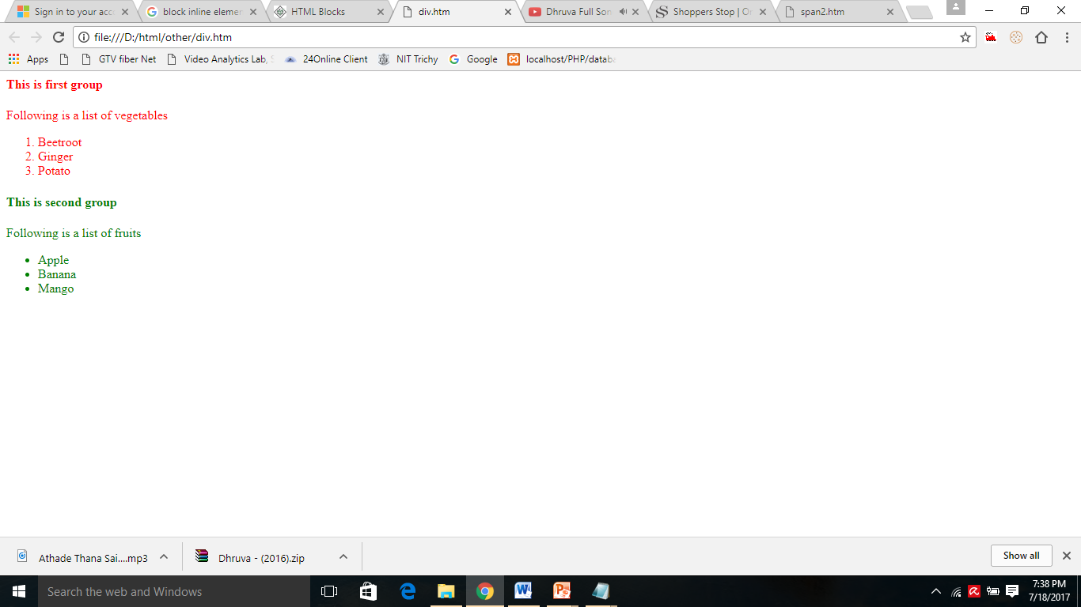

Slide 105
Inline Elements
Inline elements don’t break the text before and after them
Inline elements, on the other hand, can appear within sentences and do not have to appear on a new line of their own.
The <b>, <i>, <u>, <strong>, <sup>, <sub>, <li>, <del>,<span>.

Slide 106
<span> Tag
Useful for modifying a specific portion of text
Don't create a separate area (paragraph) in the document
Very useful with CSS
The HTML <span> is an inline element and it can be used to group inline-elements in an HTML document.

Slide 107
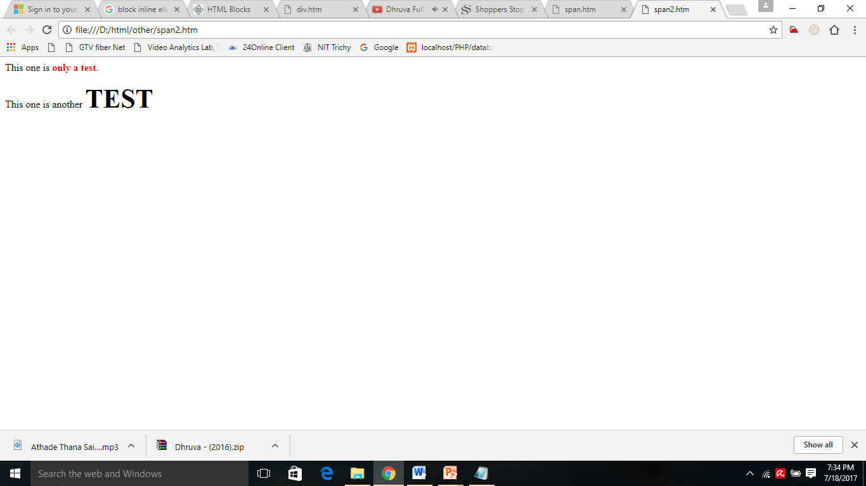
<html>
<p>This one is <span style="color:red; font-weight:bold">only a test</span>.</p>
This one is another <span style="font-size:42px; font-weight:bold">TEST</span>
</html>

